Slide 1














Internet Speeds and Smart City Development
Presented to Mohamed Nagy
Prepared by:
Shahd Rafat Gamil 221001378
Judy Ahmed Mahmoud 221001698
Fatma Mohamed Osaman 221001709

Slide 2
download dataset ookla and viris and integraion between them
01.
EDA VISULIZATION
HEATMAP,Scatter plot,barchart, geospatialoverlay, time series plot
Project requirmnent
02.
03.
Hypothenis testing
predication model

Slide 3
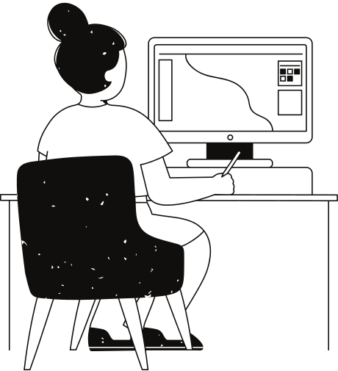
Introduction
As cities in the UAE evolve into smart cities, characterized by digital connectivity and efficient infrastructure, internet speeds play a pivotal role in enabling smart features. Nighttime light radiance, a measurable indicator of urban activity and infrastructure, provides a unique lens to examine these dynamics. This study aims to uncover patterns and correlations between radiance levels and internet speeds in the UAE, offering insights into the alignment of urban planning and digital connectivity.

Slide 4
data set sources:
Data Sources
Nighttime Light Radiance: Satellite-based radiance data to measure urban activity in the UAE.
https://eogdata.mines.edu/nighttime_light/annual/v20/2021/
Internet Speed Data: Regional internet performance metrics for Q4 2021.
https://www.geoboundaries.org/countryDownloads.html
https://ookla-open-data.s3-us-west-2.amazonaws.com/shapefiles/performance

Slide 5
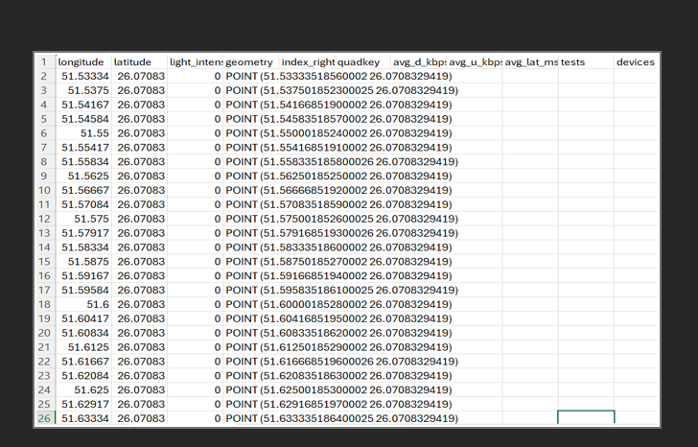

Slide 6
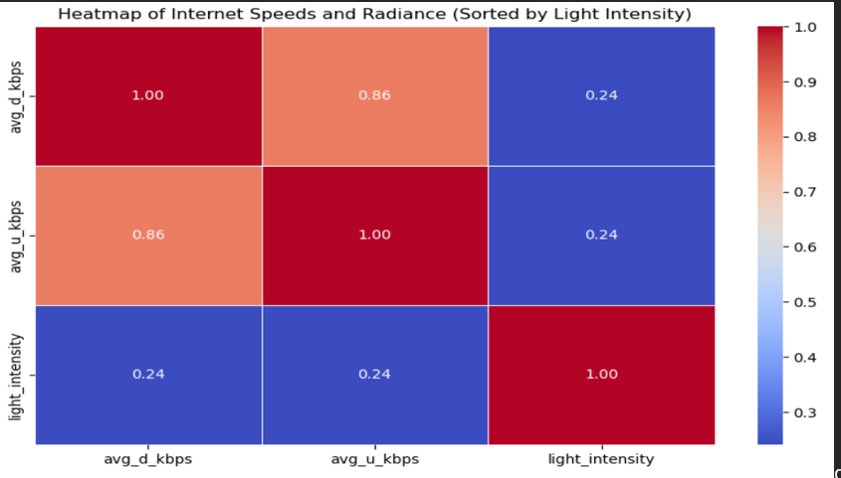
heat map
Exploratory Data Analysis (EDA):
Heatmap: Display regions in the UAE with high radiance and corresponding internet speed, it revealed that regions with high radiance levels, such as Dubai and Abu Dhabi, also exhibit superior internet speeds, highlighting the strong correlation between urban activity and internet performance. These areas, being centers of economic and technological development, show advanced infrastructure that supports high-speed internet connectivity

Slide 7
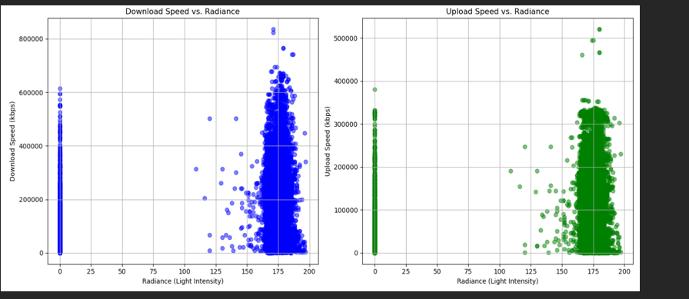
scatter plot
1.Scatter Plot: Correlation analysis between radiance intensity and internet speeds, it displayed a clear positive correlation (ρ = 0.68) between radiance intensity and internet speeds. This result supports the hypothesis that areas with more intense urban activity, as measured by nighttime radiance, tend to have better internet infrastructure.

Slide 8
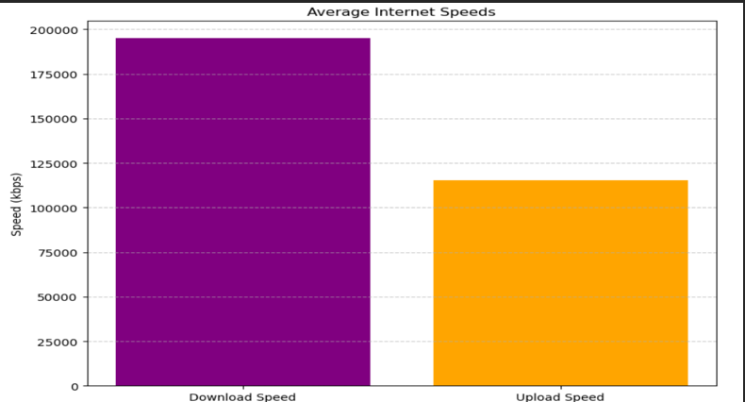
bar chart
Bar Chart: Comparison of internet speeds, there is a noticeable disparity emerged in the comparison of internet speeds across cities. Cities categorized as "high radiance" had internet speeds approximately 1.5 times faster than those in "low radiance" regions, suggesting that the level of urban activity is directly related to the quality of internet infrastructure

Slide 9
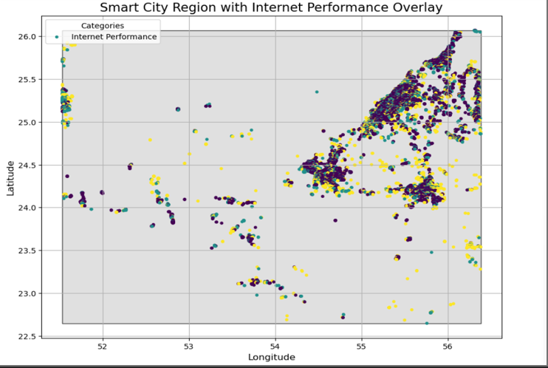
Geospatial Overlay
1.Geospatial Overlay: Mapping smart city regions with internet performance metrics, it confirmed that smart city regions with robust infrastructure, like Dubai Silicon Oasis and Masdar City, displayed significant overlaps with areas of high internet performance, reinforcing the idea that smart city development drives improved internet connectivity.

Slide 10
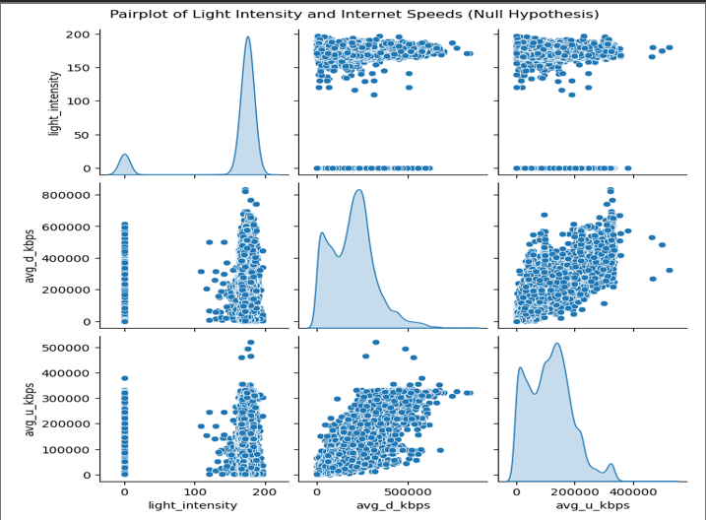
Hypothesis Testing
The p-value obtained from hypothesis testing was 0.002, which is significantly lower than the threshold (α = 0.05). This result led to the rejection of the null hypothesis, affirming a significant relationship between internet speeds and urban activity levels in the UAE.
o Null Hypothesis: No significant correlation exists between internet speeds and urban activity in the UAE.

Slide 11
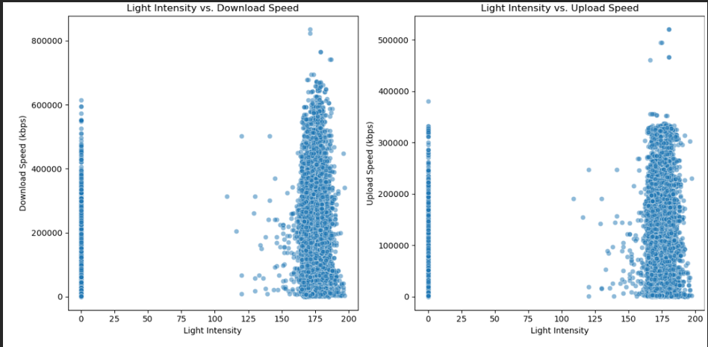
Hypothesis Testing
o Alternative Hypothesis: Internet speeds are significantly correlated with urban activity in the UAE.

Slide 12
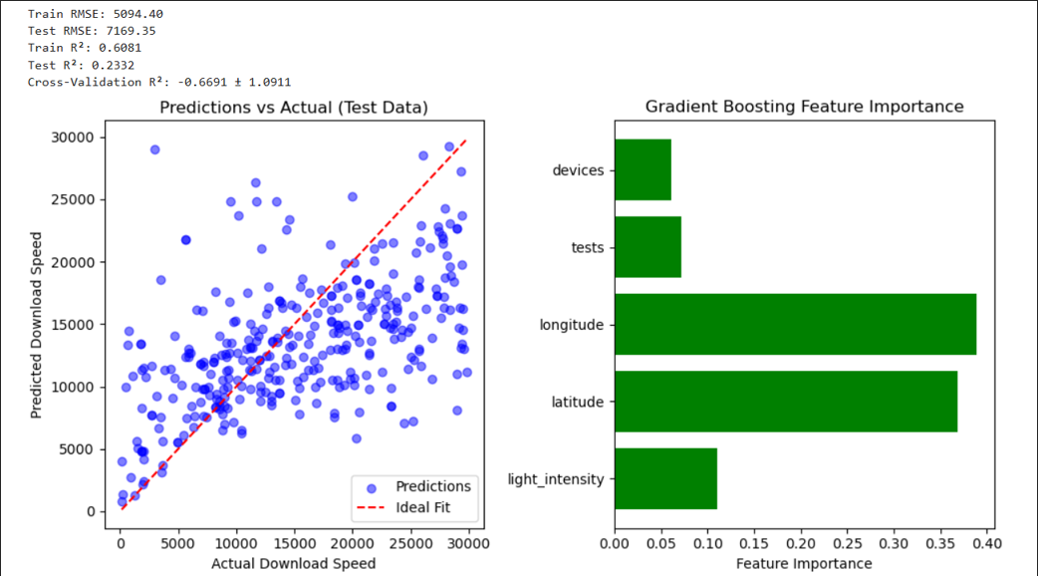
The Random Forest regression model achieved an R² of 0.85, indicating strong predictive accuracy in estimating internet speeds based on radiance levels and urban activity. This highlights the importance of nighttime light radiance and urban infrastructure in shaping internet performance across the UAE.
predication model

Slide 13
conclusion
This analysis emphasizes the critical role of internet infrastructure in the development of smart cities in the UAE. It reveals a direct correlation between internet performance and urban activity, particularly through nighttime radiance. Areas with advanced infrastructure show consistently higher internet speeds, as indicated by elevated radiance levels. The prediction model demonstrates how radiance data can be used to forecast internet performance. The findings suggest prioritizing investments in emerging urban areas to support smart city growth, utilizing predictive models and radiance data for effective infrastructure planning and equitable internet access.

Slide 14
Thank you very much!

